Slide 1
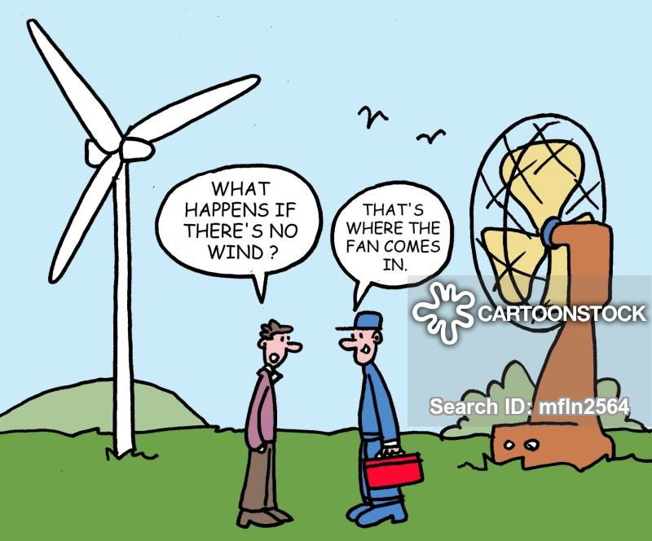
Power Guide
Eren ÖZKARA
Büşra Nur KOÇAK
Yunus ÇAY

Slide 2
ıntroductıon
Final Topology
Simulation Results
Component Selection
Inductor Design
PCB Design
Control System
Thermal Calculations
Cheapest Design Bonus
Utilization Bonus
Industrial Product Bonus
Thermal Simulation Bonus

Slide 3
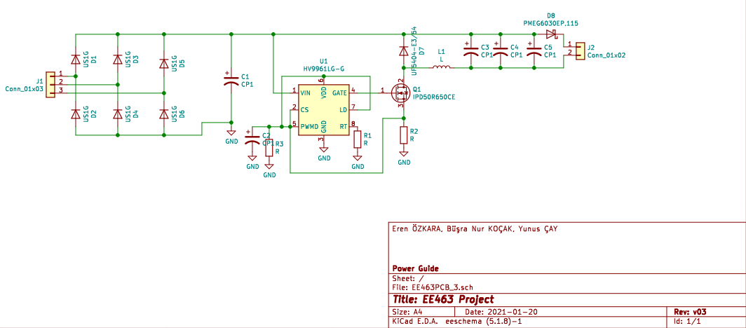
FINAL TOPOLOGY
Figure 1. Final Topology of the Project

Slide 4
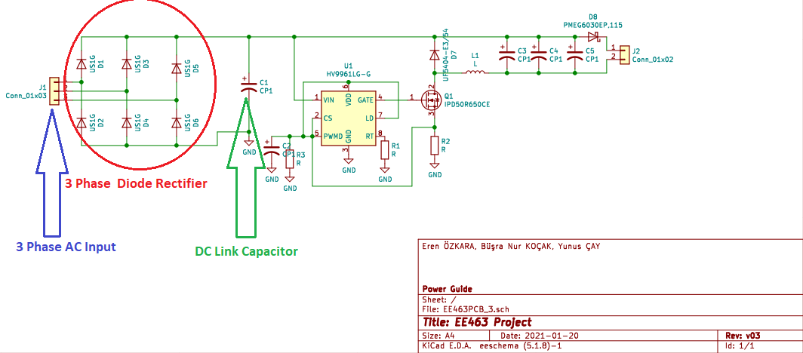
Figure 2. Rectifier Side of the Topology

Slide 5
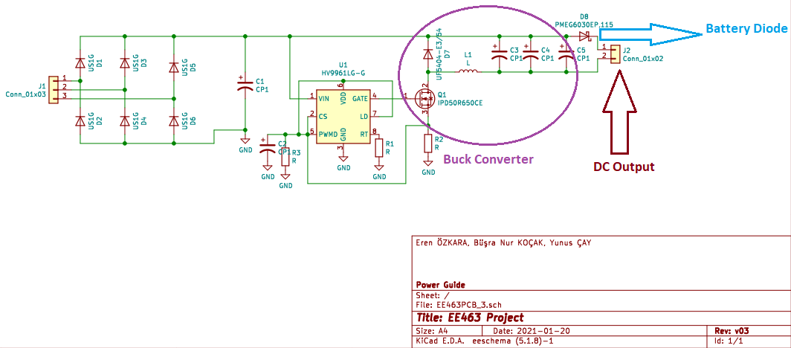
Figure 3. Buck Converter Side of the Topology

Slide 6
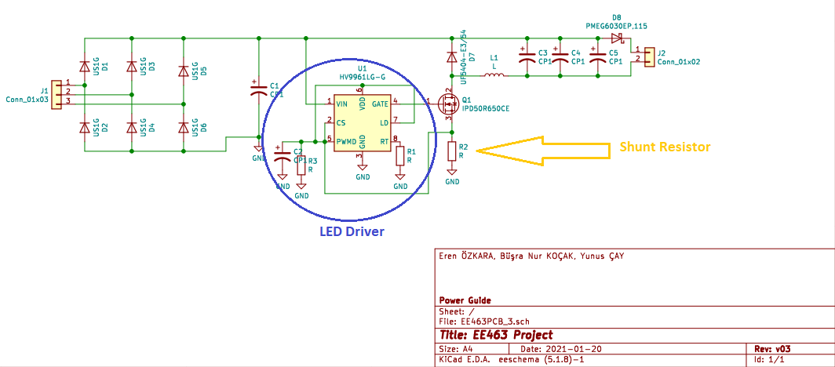
Figure 4. Controller Side of the Topology

Slide 7
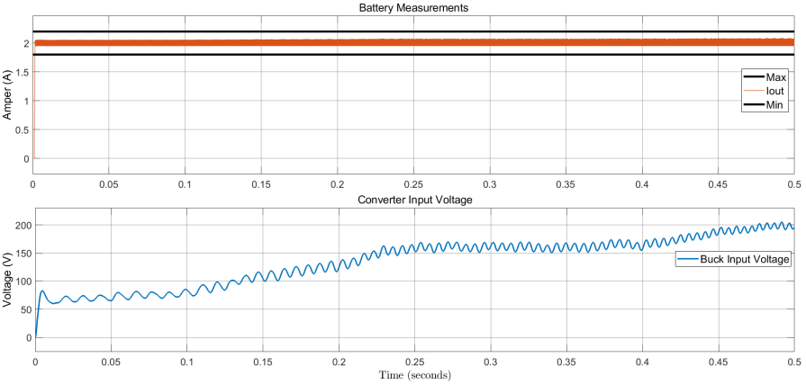
SIMULATION RESULTS
Figure 5. Results under Normal Conditions

Slide 8
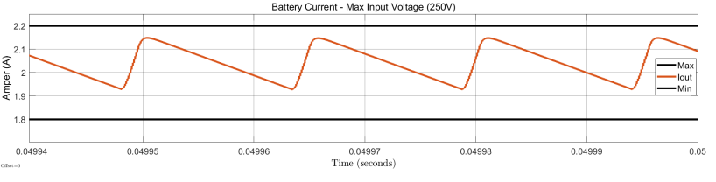
Figure 6. Battery Current when Vin 250 V

Slide 9


Component selectıon

Slide 10
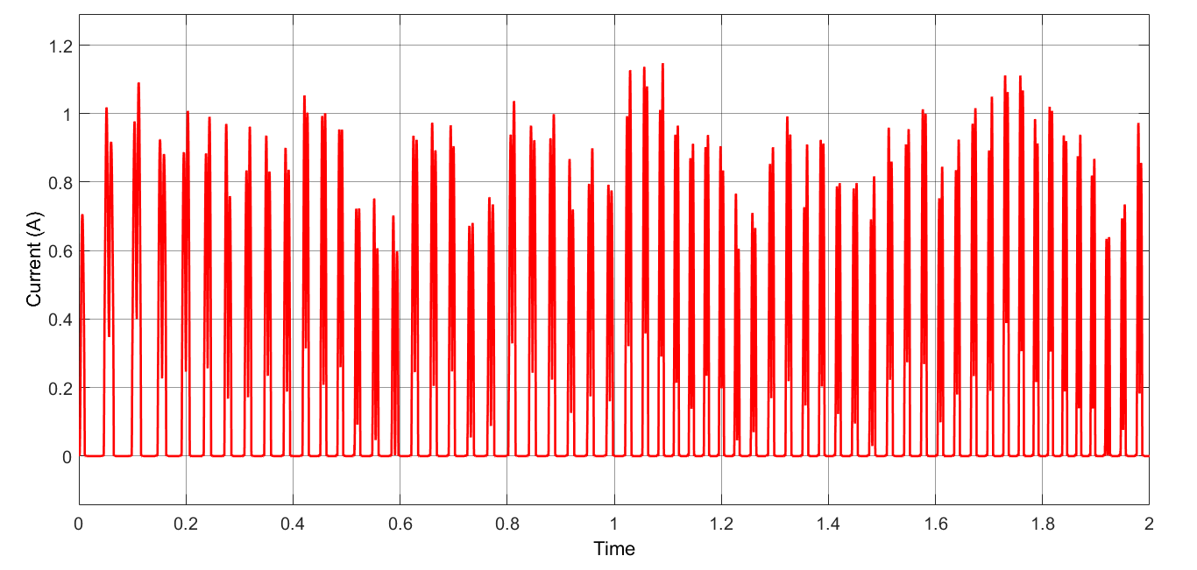
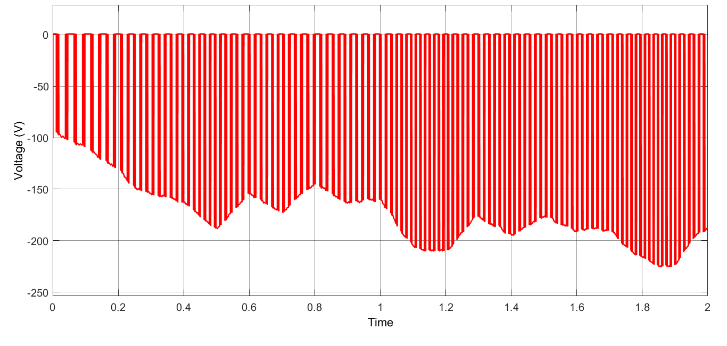
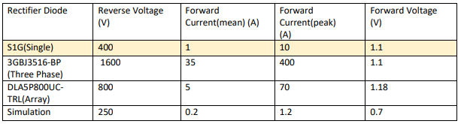
Rectıfıer dıode
Figure 7. Voltage and Current Waveforms of Rectifier Diode
Table 1. Rectifier Diode Selection Table

Slide 11
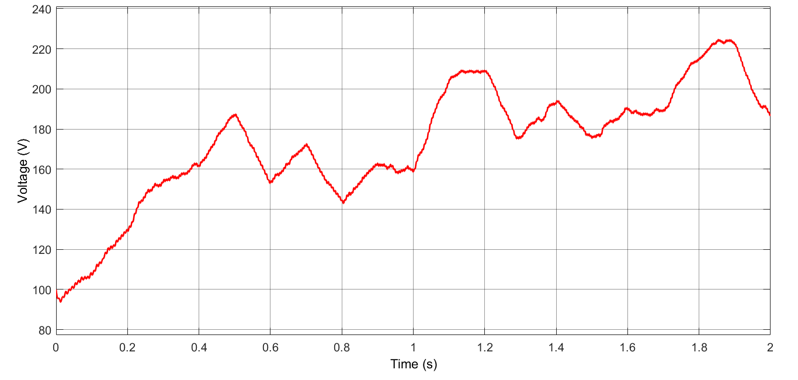
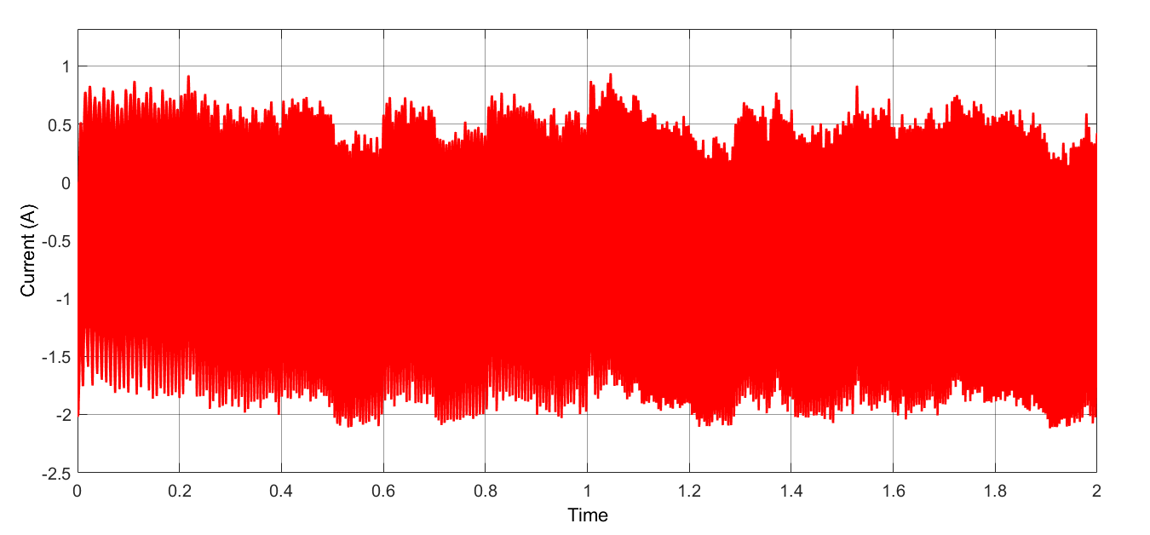
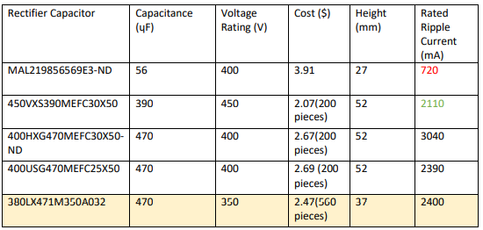
Dc lınk capacıtor
Figure 8. Voltage and Current Waveforms of DC Link Capacitor
Table 2. DC Link Capacitor Selection Table

Slide 12
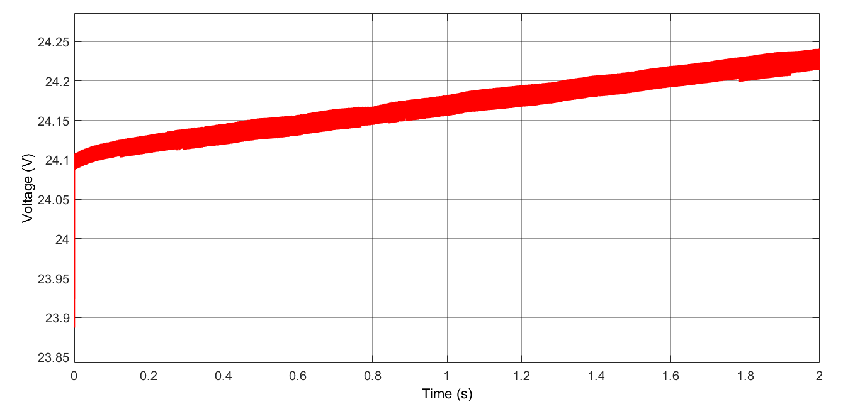
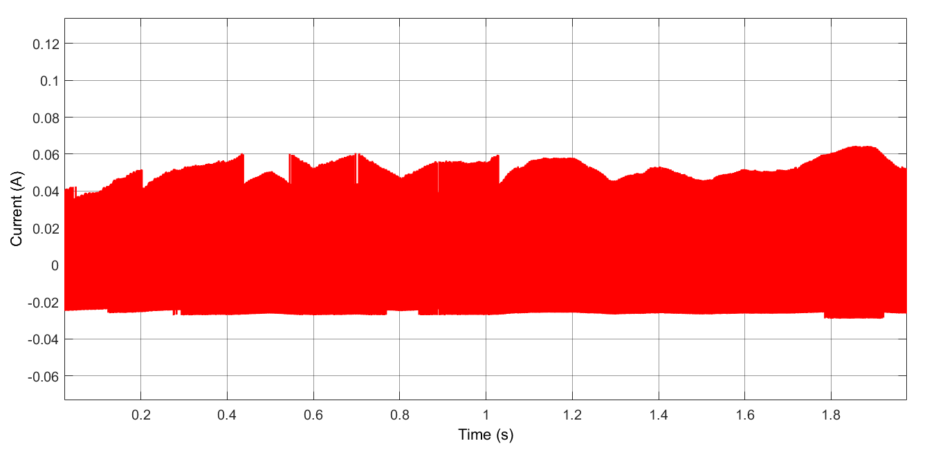
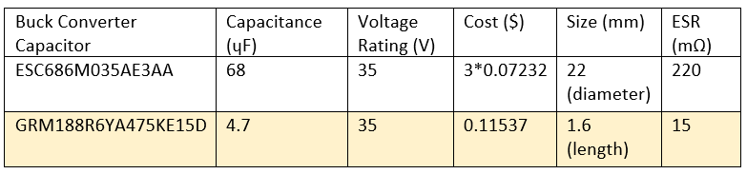
BUCK CONVERTER CAPACITOR
Figure 9. Voltage and Current Waveforms of Buck Converter Capacitor
Table 3. Buck Converter Capacitor Selection Table

Slide 13
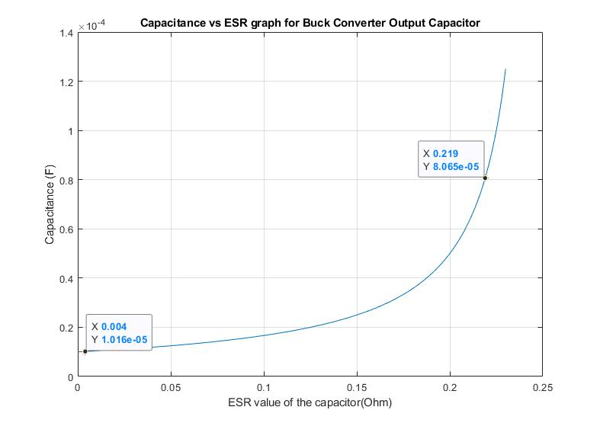
Figure 10. Capacitance vs ESR graph for Buck Converter Output Capacitor

Slide 14
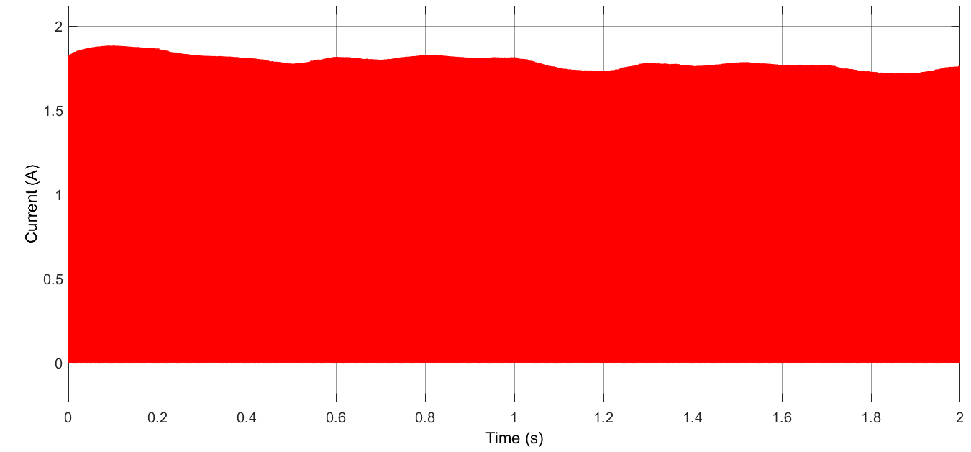
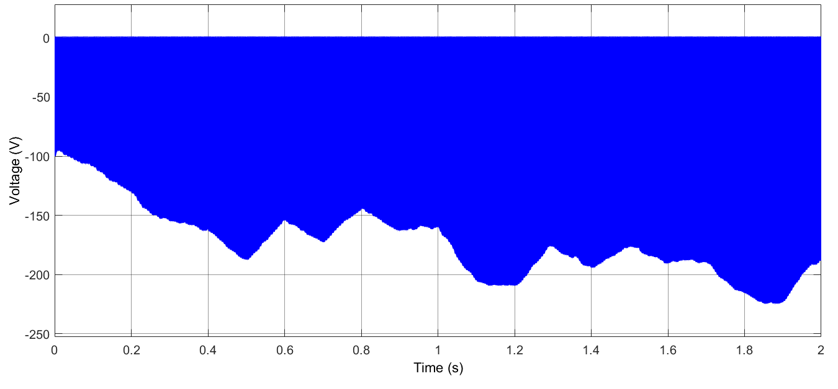
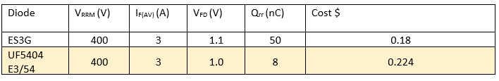
Buck Converter dıode
Figure 11. Voltage and Current Waveforms of Buck Converter Diode
Table 4. Buck Converter Diode Selection Table

Slide 15
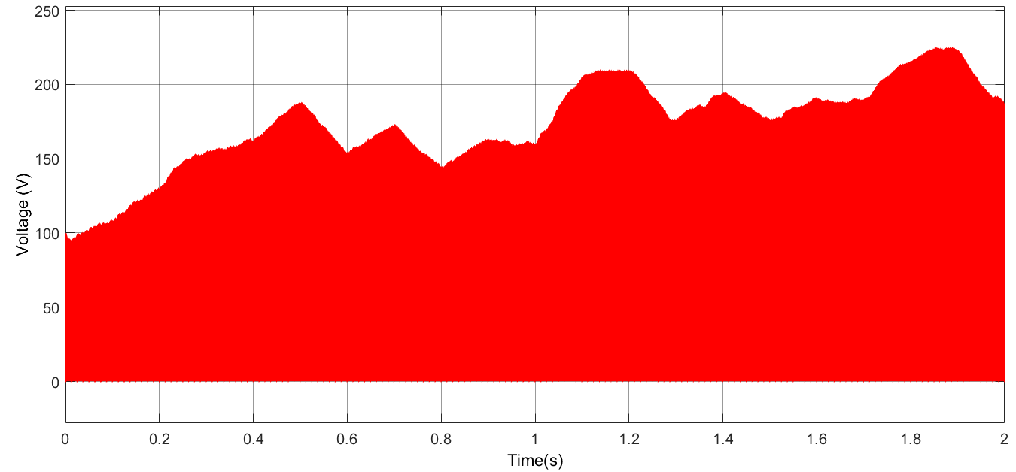
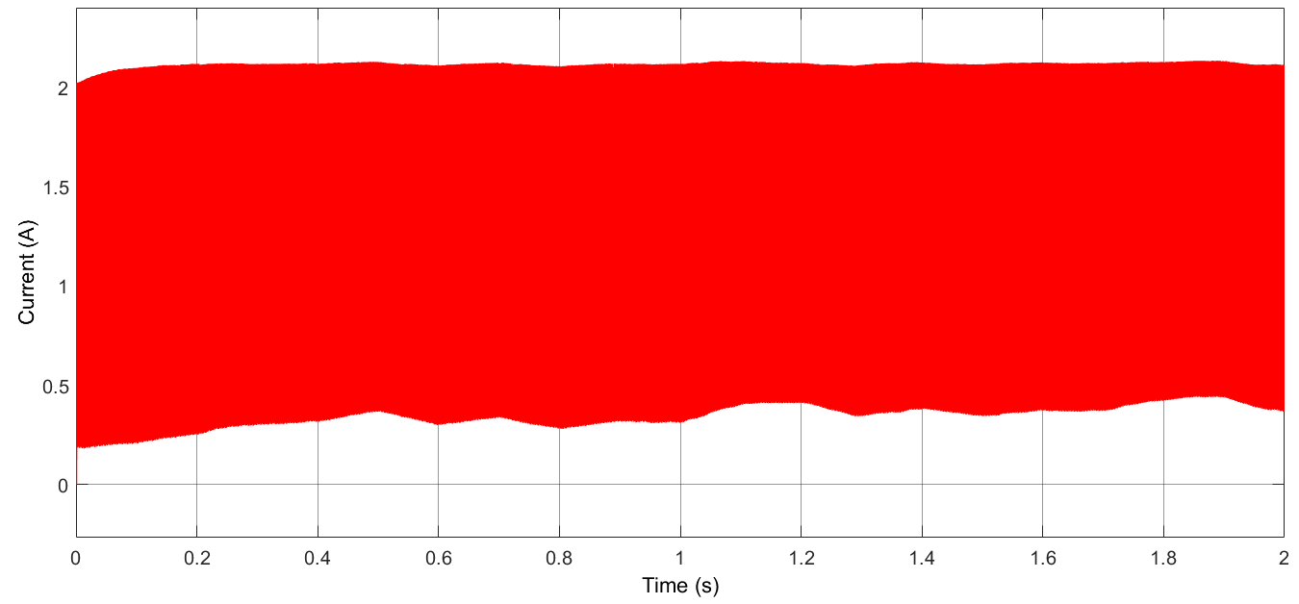
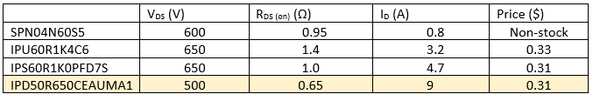
BUCK CONVERTER SWITCH
Figure 12. Voltage and Current Waveforms of Buck Converter MOSFET
Table 5. Buck Converter MOSFET Selection Table

Slide 16
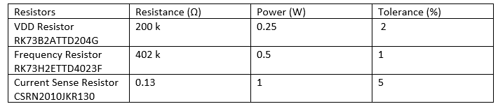
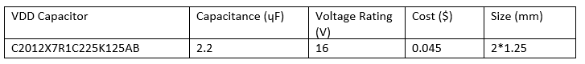
cONTROLLER
Table 6. Controller Selection

Slide 17
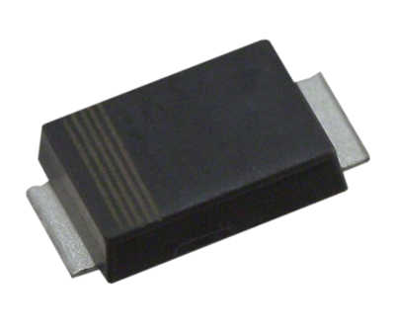
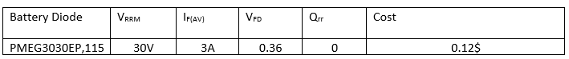
Battery dıode
Figure 13. Schottky Diode
Table 7. Battery Diode Selection Table

Slide 18
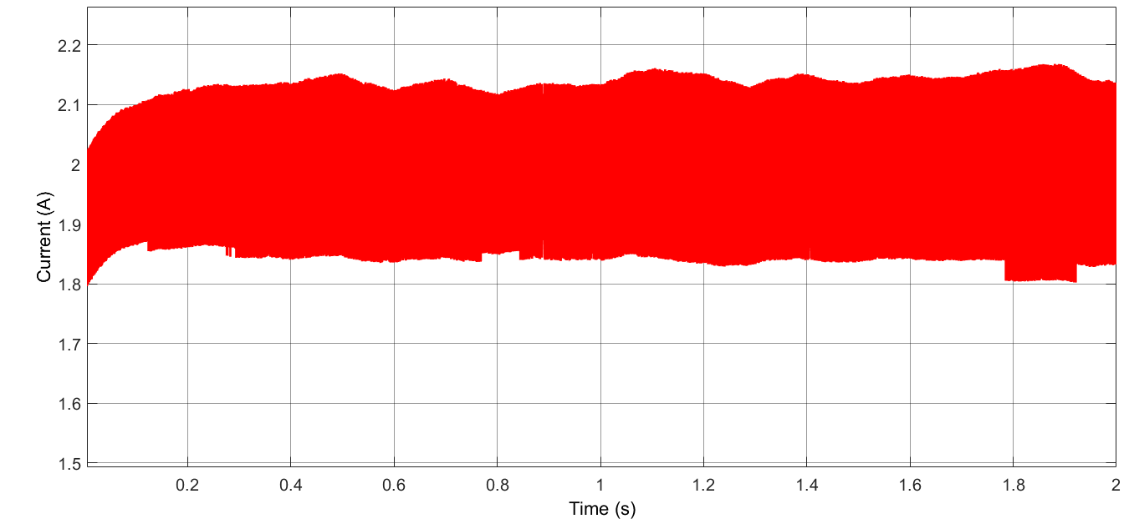
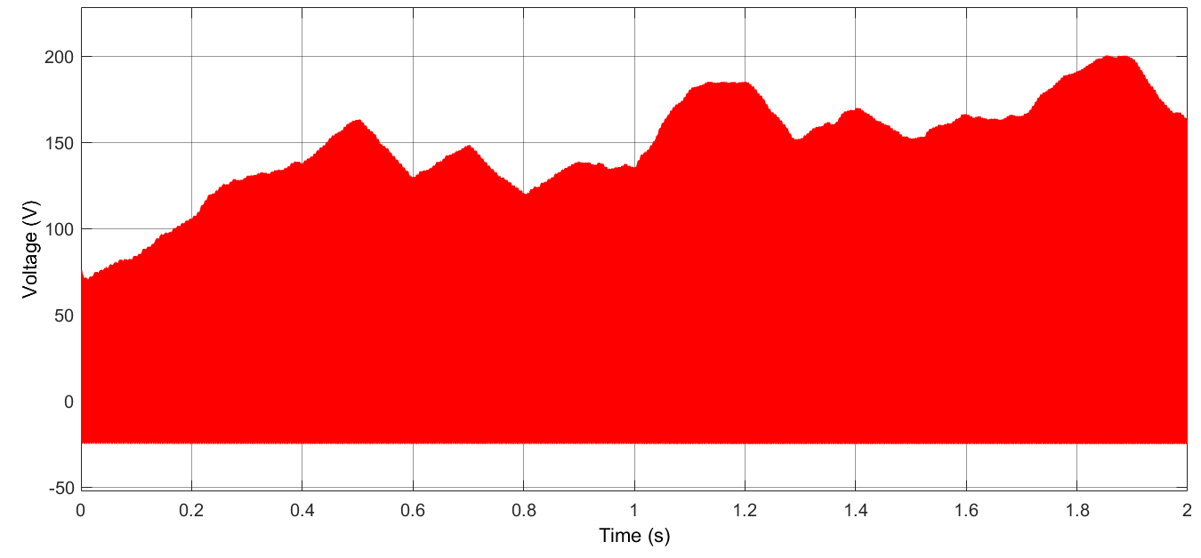
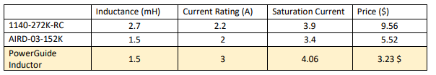
Buck converter ınductor
Figure 14. Voltage and Current Waveforms of Buck Converter Inductor
Table 8. Buck Converter Inductor Selection Table

Slide 19
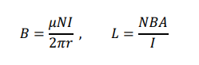
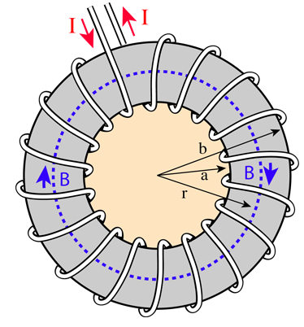
INDUCTOR DESIGN
Toroidal Shape Cores
Ferrite Cores
Iron Powder Cores
CABLE
22 AWG
Figure 15. Core Shape of Toroid

Slide 20
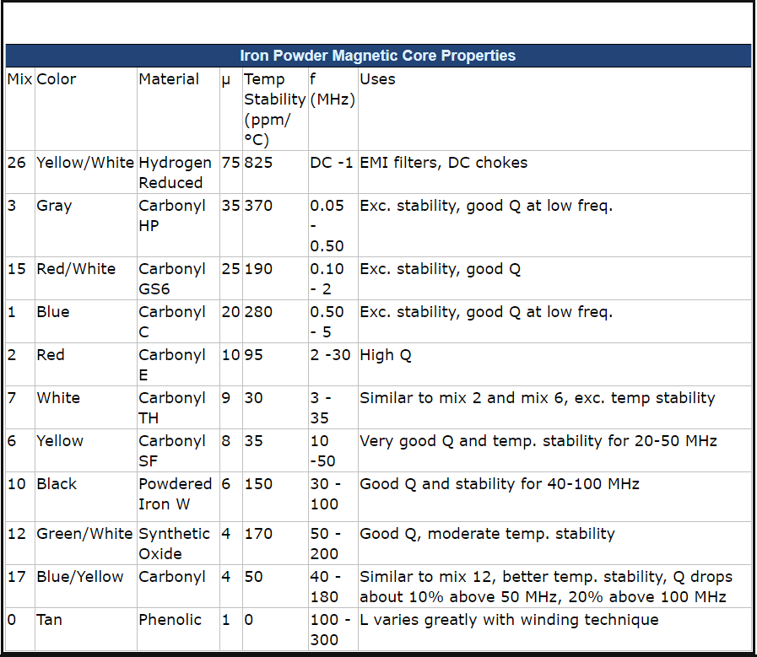
CORE MATERIAL TYPE
Table 9. Core Material Type Table

Slide 21
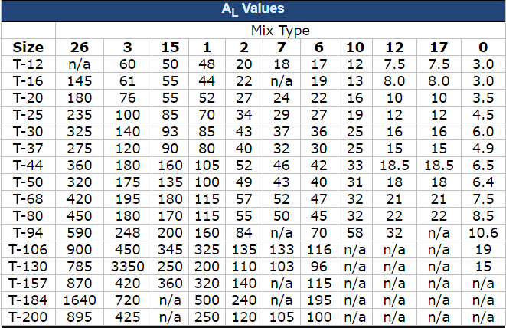

CORE MATERIAL SIZE
Table 10. Core Material Size Table
$$N=100∗ \sqrt{\frac{L}{A_{L}}}, L= A_{L}∗\left(\frac{N^{2}}{{10}^{4}}\right)$$
N = 182 turns
B = 0.266 T

Slide 22
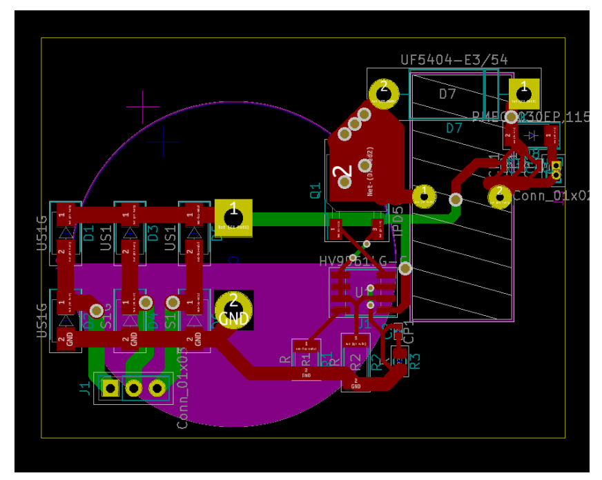
PCB DESIGN
IPC2221B
EMI Effect
Efficiency
Cost
Size
Heat
Figure 16. PCB Design

Slide 23
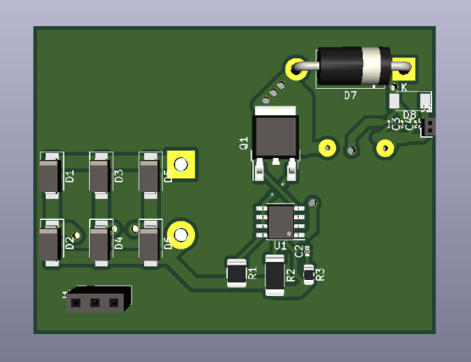
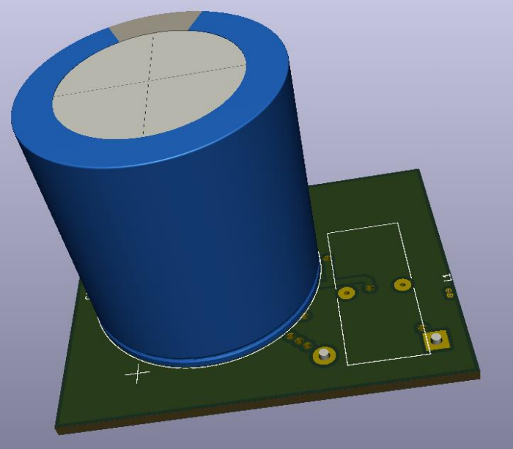
TOP AND BOTTOM LAYERS OF THE PCB
Figure 17. 3D Shape of PCB Design

Slide 24
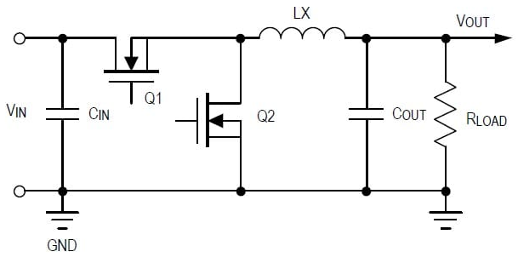
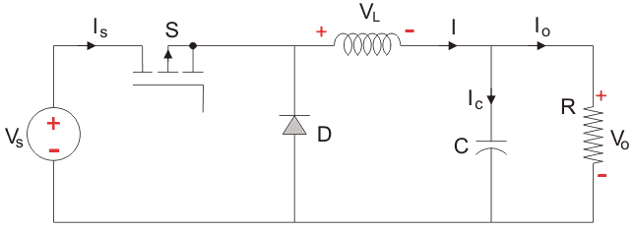
Control System Switching Topology
Synchronous Converter
Non-synchronous Converter
Figure 18. Synchronous and Non-synchronous Converter Topology

Slide 25
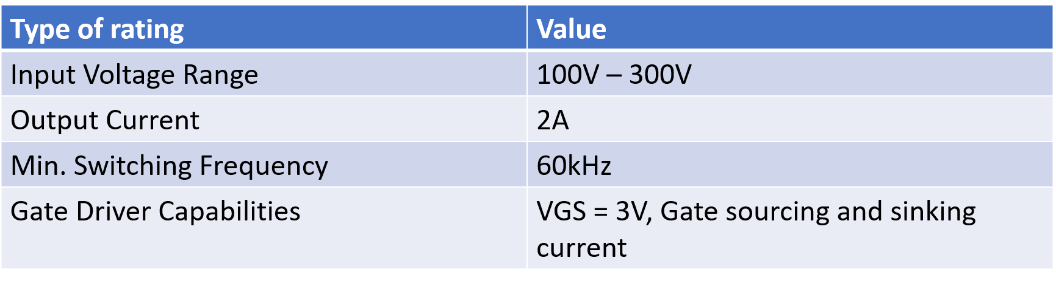
Control System Ratings
Table 11. Controller Ratings

Slide 26

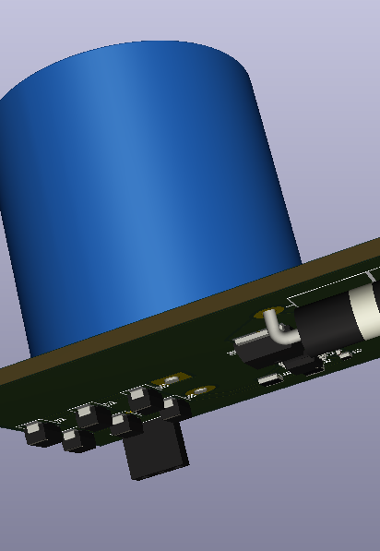

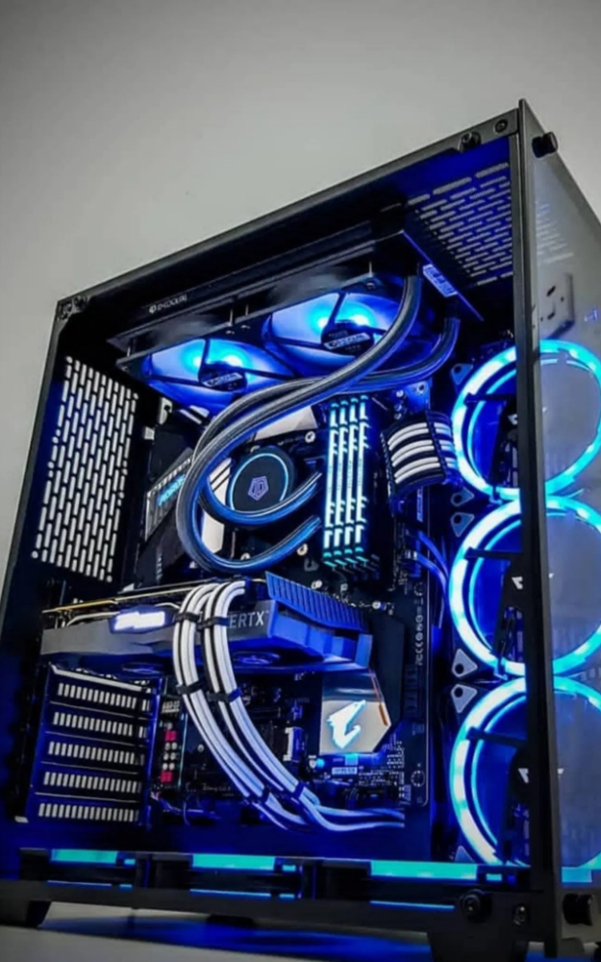
Control System Desired Characteristics
Cheap design
Small volume
Avoiding overdesing

Slide 27
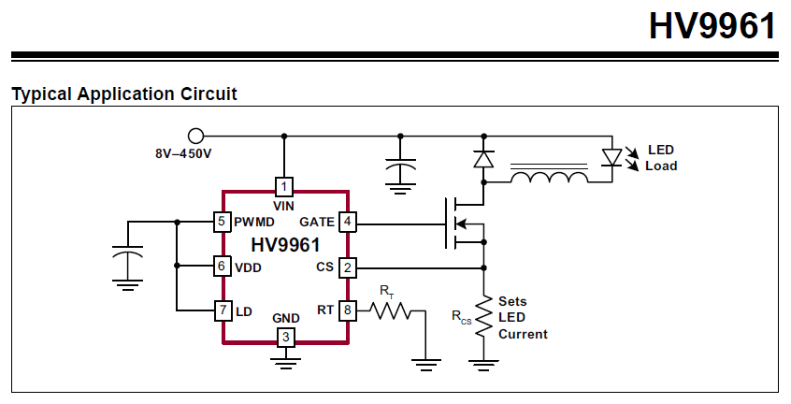
Control System Selected Controller
Desired characteristics and ratings of the control system restricts the controller to a single type of controller.
External regulator
Figure 19. HV9961 Typical Application

Slide 28
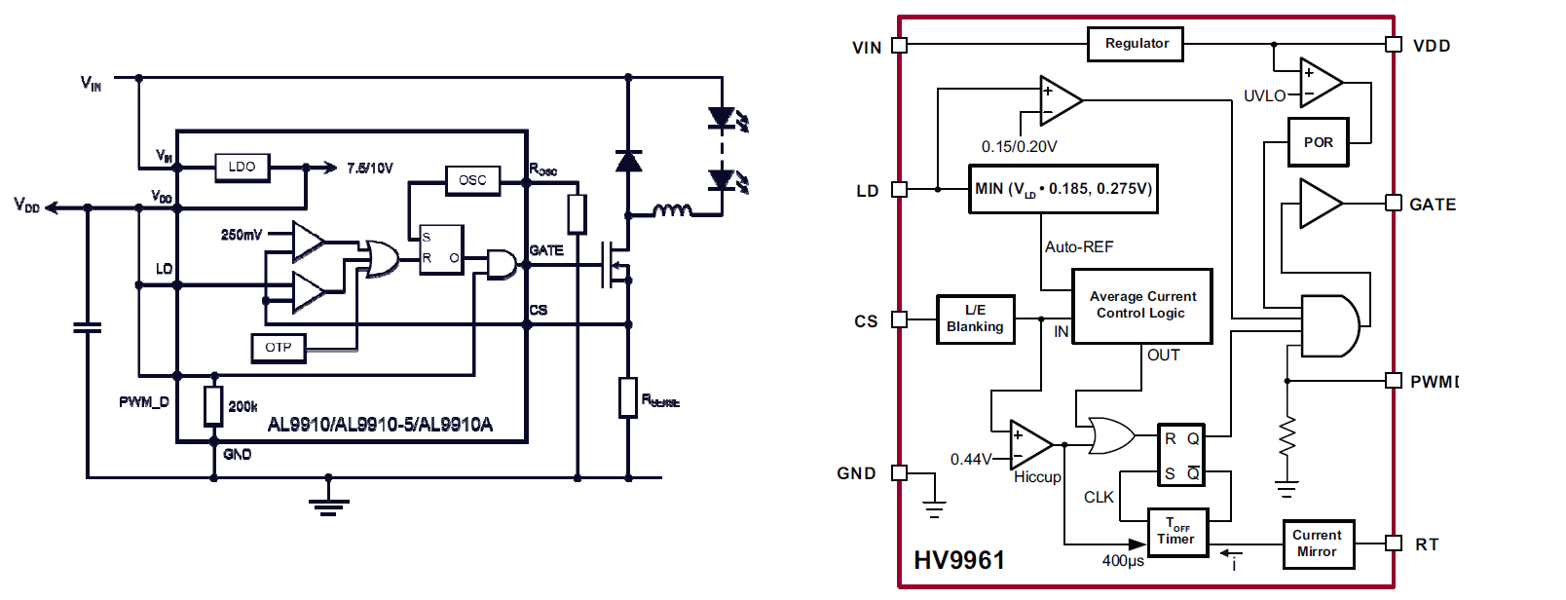
Control System Comparison of the Formal and the Latter Controller
Frequency
Average Current Control Logic
The formal controller
AL9910A
The latter controller
HV9961
Figure 20. AL9910A and HV9961 Controllers

Slide 29
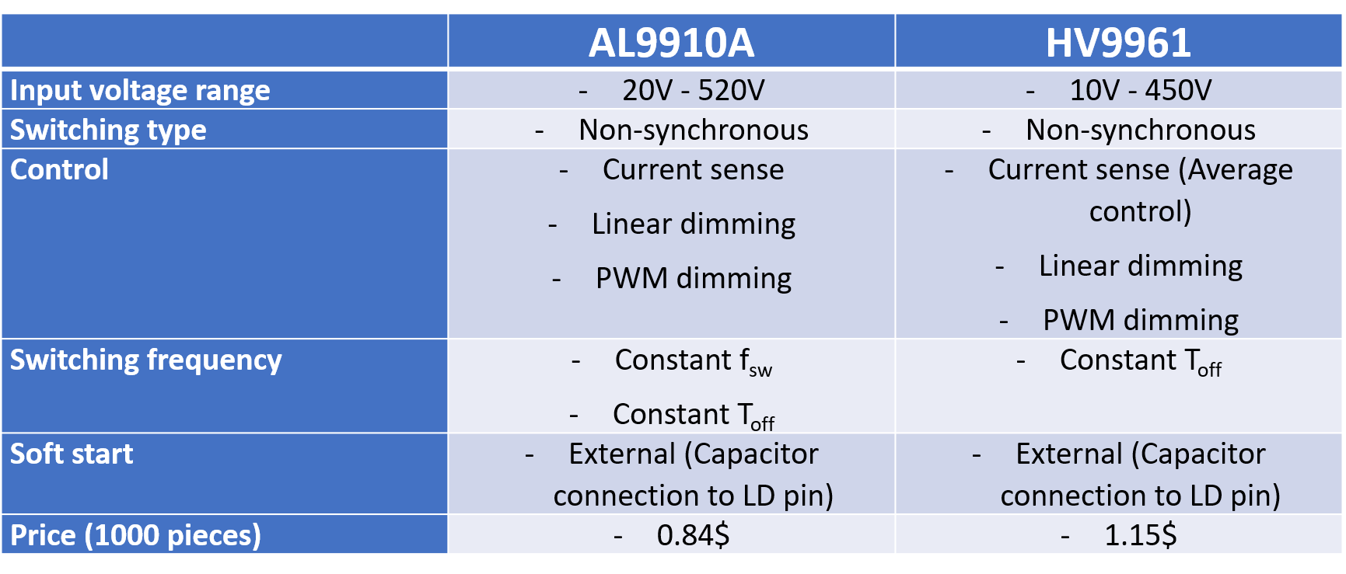
Control System Comparison of the Formal and the Latter Controller
Table 12. AL9910A vs HV9961

Slide 30


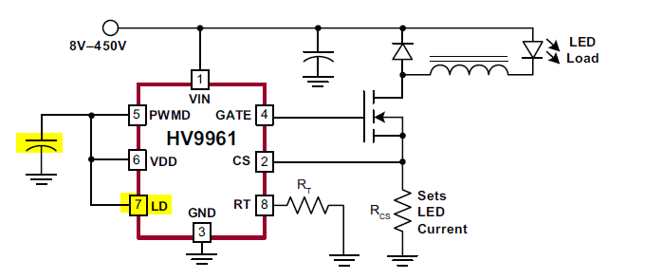
Control System Current Control, Switching Frequency and Soft-start
Figure 21. HV9961 Control System

Slide 31
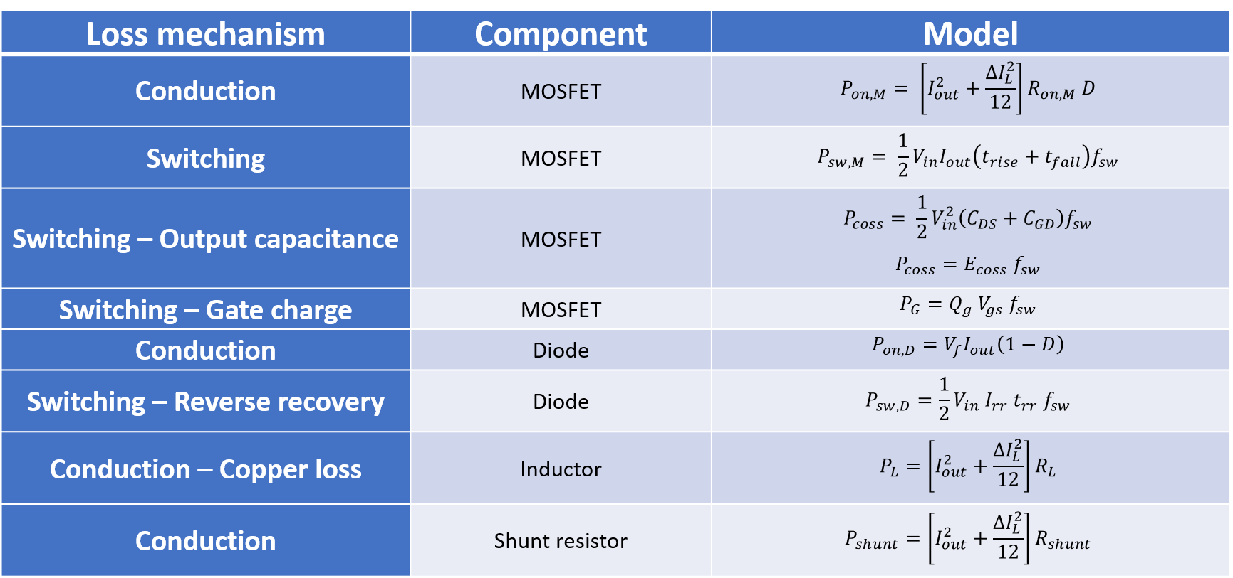
Thermal Management Loss Calculations
Table 13. Loss Calculation Modeling

Slide 32
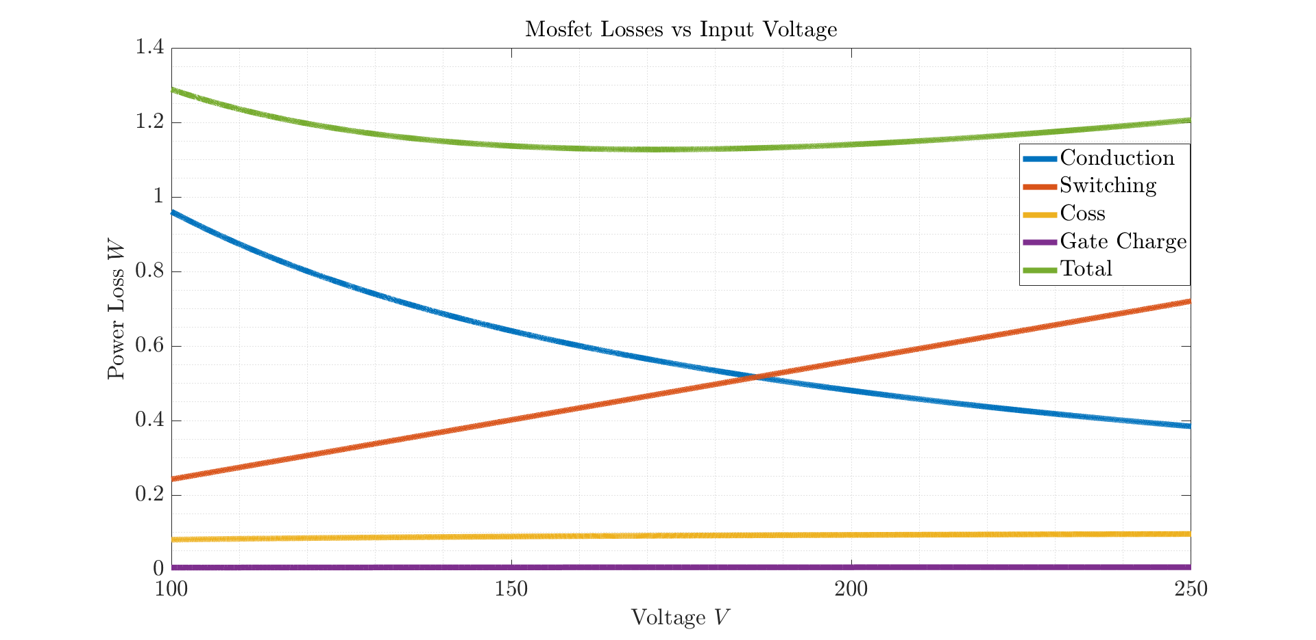
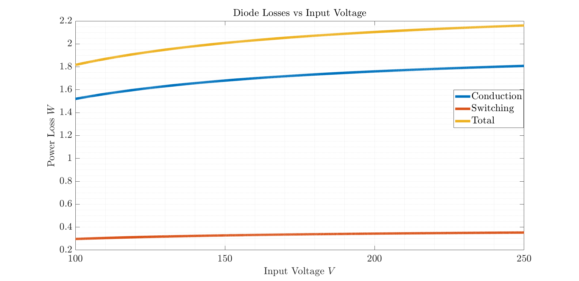
Thermal Management Loss Calculations – Semiconductors
Figure 22. MOSFET and Diode Losses vs Input Voltage

Slide 33
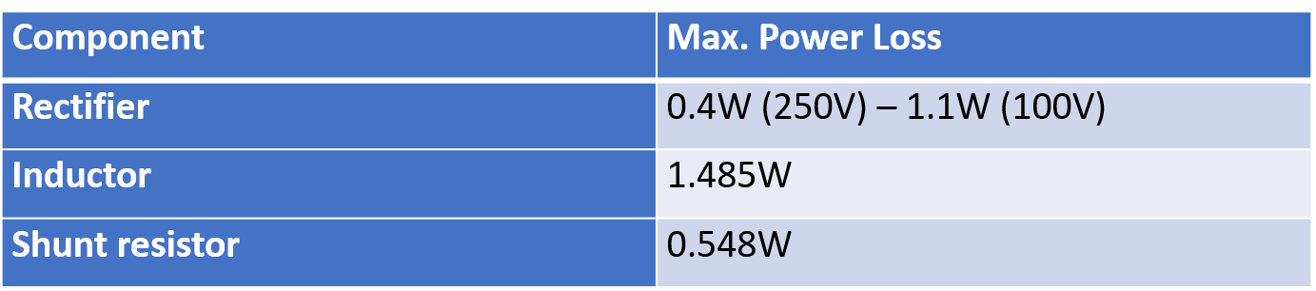


Thermal Management Loss Calculations – Rectifier & Inductor & Shunt Resistor
Table 14. Power Loss of Components
Figure 23. Inductor and Shunt Resistor

Slide 34

Thermal Management Efficiency
Figure 24. Efficiency vs Input Voltage Graph

Slide 35


Thermal Management Thermal Calculation - MOSFET
Iterative calculation due to on resistance of MOSFET.
Table 15. Iterative Calculation Table
Figure 25. Ron Resistance vs Temperature

Slide 36


Thermal Management Thermal Calculation - MOSFET & Diode
Table 16. Diode Loss and Junction Temperature

Slide 37

Table 17. Bill of Materials

Slide 38

Utılızatıon bonus
Table 18. Utilization Bonus Table

Slide 39

INDUSTRIAL DESIGN
Aluminum
46x59x51 mm
138.414 cm^3
Figure 26. Industrial Box for the Circuit

Slide 40

Thermal Management Thermal Simulation
Hand Calculation
Omit the worse options
Thermal Simulation
Better results to determine
Natural convection
Flow Analysis and Thermal Simulation
Assumptions are taken into account
Forced convection
Figure 27. Thermal Simulation

Slide 41

Thermal Management Thermal Simulation
Table 19. Simulation Inputs

Slide 42

Thermal Management Thermal Simulation
Figure 28. SolidWorks Thermal Simulation

Slide 43

THANKS FOR LISTENING
☺

